Slide 1








Trend of technology skills requirement

Slide 2



OUTLINE
Executive Summary
Introduction
Methodology
Results
Visualization – Charts
Dashboard
Discussion
Findings & Implications
Conclusion
Appendix

Slide 3

EXECUTIVE SUMMARY
Analysis current desirable technology skills
Data Collection
Job postings in U.S.
Training portals
Survey
Javascript, html, python
What are the popular IDEs?

Slide 4

INTRODUCTION
Programming has been the most desirable job skills
Keep pace with changing technologies and remain competitive
Figuring what is the most popular language and desirable.
Future implication
Training session
Talent acquisition

Slide 5

METHODOLOGY
Requesting data from Github job posting API
Web scrapping on Stack overflow survey
Exploratory data analysis
Dashboard
Current desirable language and database
Future trend
Demographic data

Slide 6
RESULTS
Most popular language: JavaScript
Most popular database: MySQL
Most popular platform: Windows
Most popular web frame: jQuery
Most desired language: JavaScript
Most desired database: PostgreSQL
Most desired platform: Linux
Most desired web frame: React.js
The data has some bias and insights should be taken with caution

Slide 7
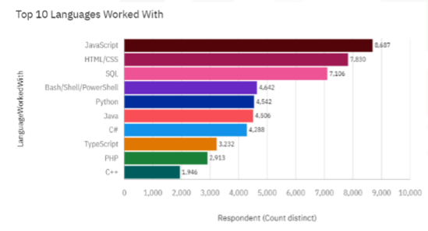
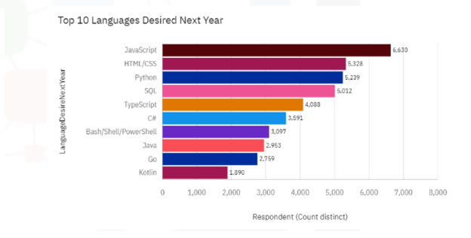
PROGRAMMING LANGUAGE TRENDS
Current Year
Next Year
<Bar chart of top 10 programming languages for the current year goes here.>
< Bar chart of top 10 programming languages for the next year goes here.>

Slide 8
PROGRAMMING LANGUAGE TRENDS - FINDINGS & IMPLICATIONS
Findings
Finding 1
Finding 2
Finding 3
Implications
Implication 1
Implication 2
Implication 3

Slide 9
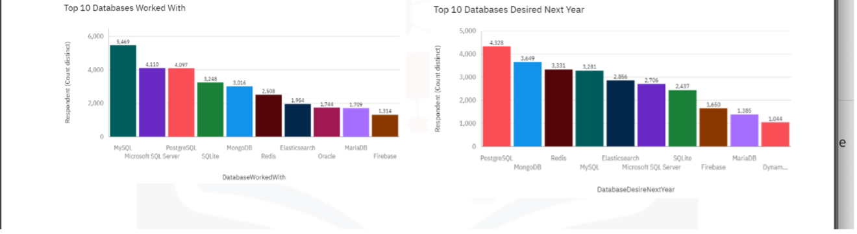
DATABASE TRENDS
Current Year
Next Year
< Bar chart of top 10 databases for the current year goes here >
< Bar chart of top 10 databases for the next year goes here.>

Slide 10
DATABASE TRENDS - FINDINGS & IMPLICATIONS
Findings
MySQL is the most popular database currently.
Followed by Postgre SQL and Microsoft SQL server
Microsoft and SQLite will be replaced by Postgre SQL and Mongo DB in next year.
Implications
It is no longer necessary to be fluent in Microsoft SQL, but knowledge of MySQL and PostgreSQL remains desirable.
Experience in MongoDB could be an advantage.

Slide 11

DASHBOARD

Slide 12
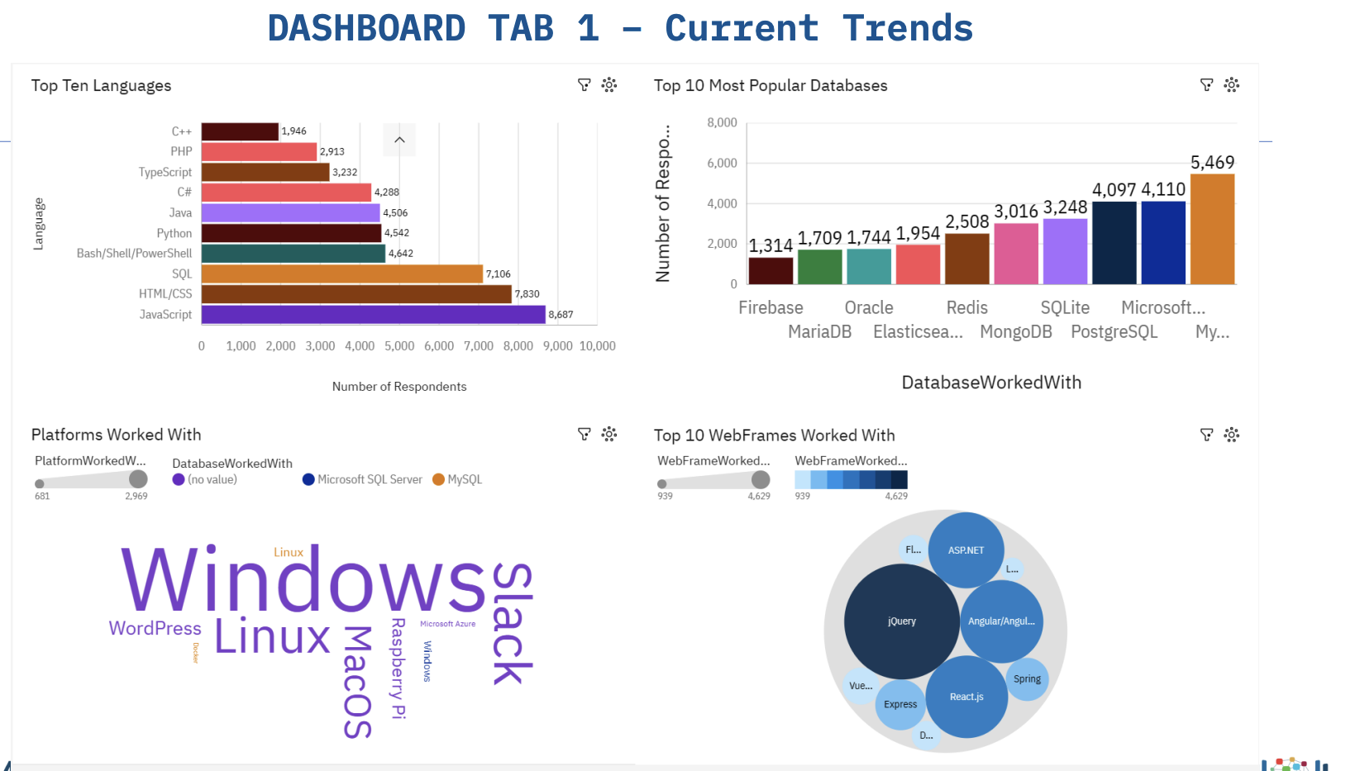
DASHBOARD TAB 1

Slide 13
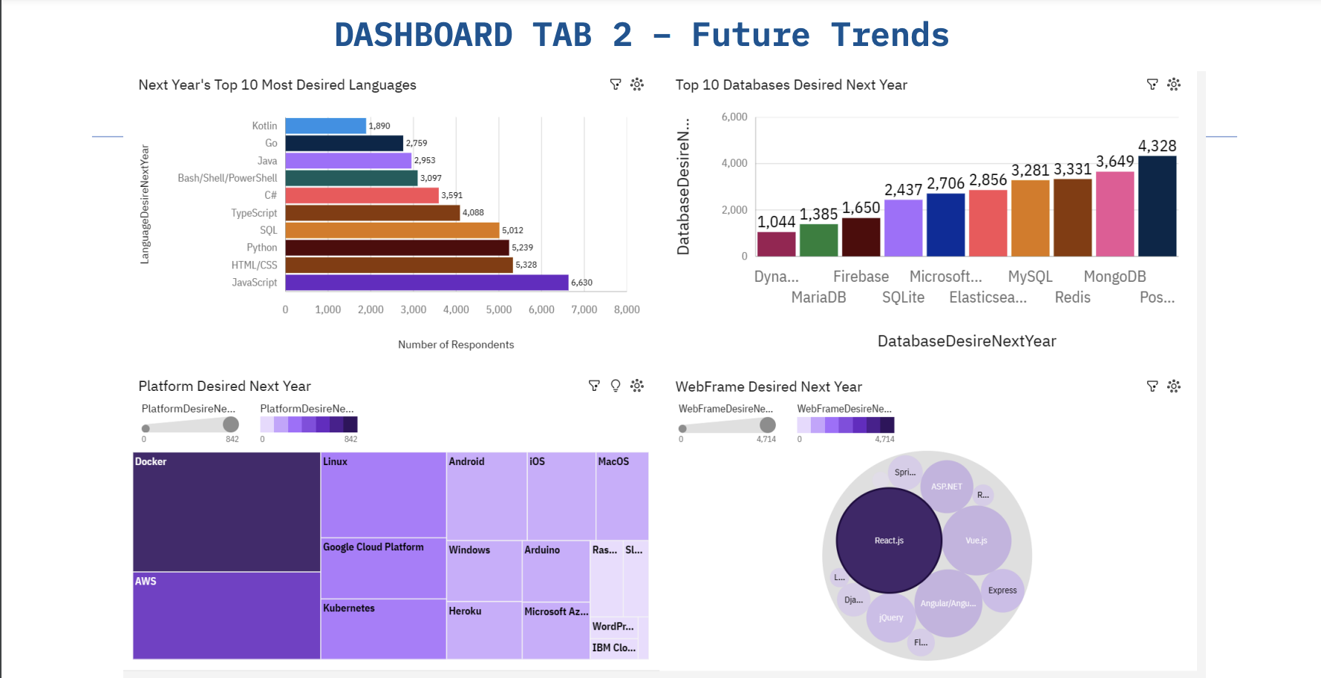
DASHBOARD TAB 2

Slide 14
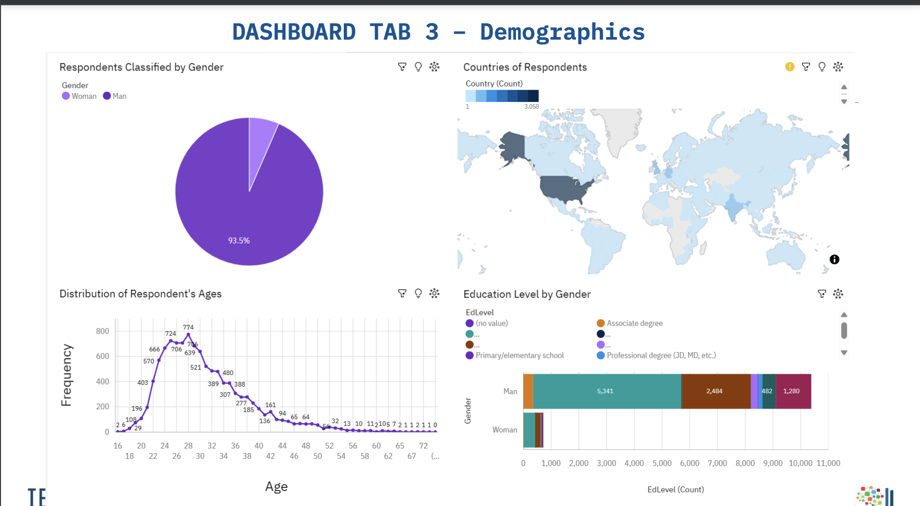
DASHBOARD TAB 3

Slide 15
DISCUSSION
-This year Windows is top desirable, yet, it will be surpassed by 7 other platforms.
-HTML/CSS is consistently popular but according to compensation data isn’t even in the Top 10 in terms of salary. Perhaps it’s an important language because it complements the others.

Slide 16
OVERALL FINDINGS & IMPLICATIONS
Findings
• Employees were mostly males between the age of 20 and 40 from the United States or India.
• Python, SQL, and JavaScript were consistently popular currently and next year.
• Windows falls from 1st to 8th. Seemingly replaced in desirability by Docker.
Implications
• The industry has room to improve when it comes to diversity. Further research is needed into why the industry is male dominated and clustered primarily in 2 countries.
• Python, SQL and JavaScript are excellent tools for a budding data analyst as they remain consistently popular.
• Desired platforms seem to change drastically. Be willing and open to learning.

Slide 17

CONCLUSION
• SQL, JavaScript and Python appear to be incredibly valuable skills for any budding developer to learn.
Consistently ranked in the Top 5 languages and they are valued highly by employers based on data pulled from job postings

Slide 18

APPENDIX

Slide 19
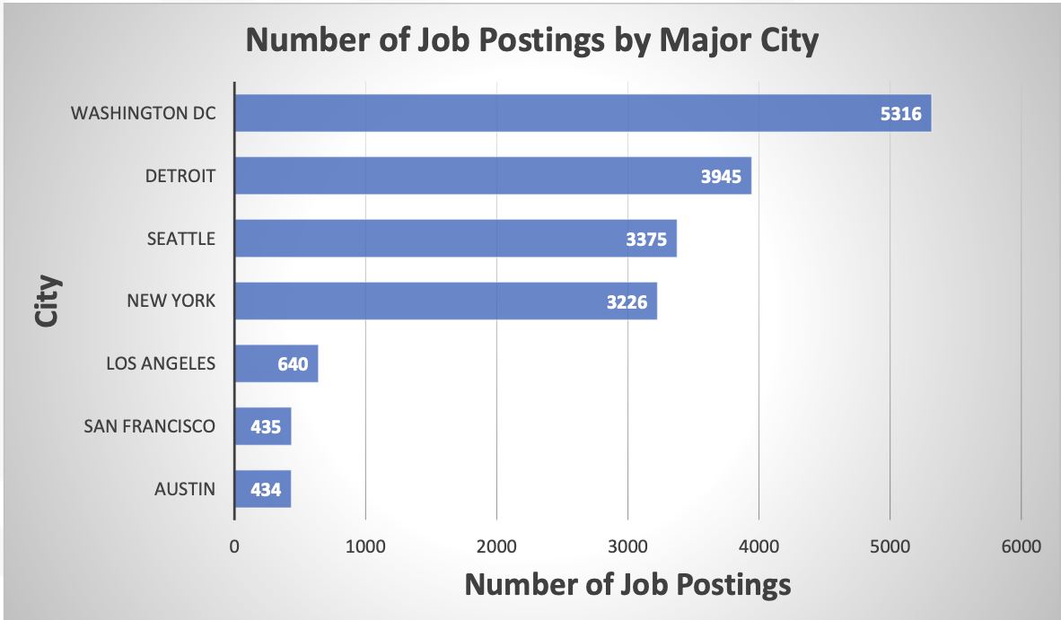
JOB POSTINGS

Slide 20
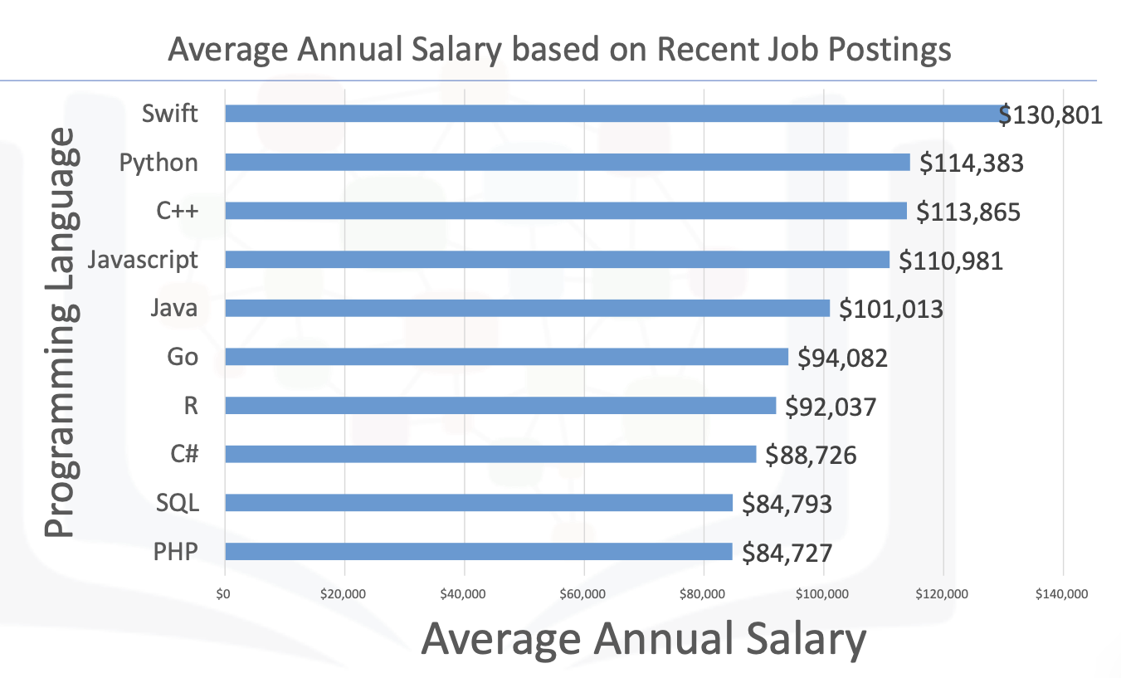
POPULAR LANGUAGES

